Slide 2
<?xml version="1.0" encoding="UTF-8"?>
<beans xmlns="http://www.springframework.org/schema/beans"
xmlns:xsi="http://www.w3.org/2001/XMLSchema-instance"
xsi:schemaLocation="http://www.springframework.org/schema/beans
http://www.springframework.org/schema/beans/spring-beans.xsd”>

Slide 3
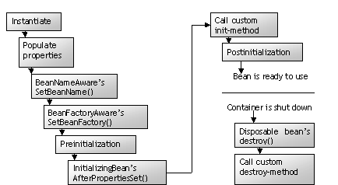

Slide 4
<beans xmlns="http://www.springframework.org/schema/beans" xmlns:xsi="http://www.w3.org/2001/XMLSchema-instance" xsi:schemaLocation="http://www.springframework.org/schema/beans http://www.springframework.org/schema/beans/spring-beans-2.5.xsd">
<import resource="common/Spring-Common.xml"/>
<import resource="connection/Spring-Connection.xml"/>
<import resource="moduleA/Spring-ModuleA.xml"/>
</beans>

Slide 5
AnnotationConfigApplicationContext context = new AnnotationConfigApplicationContext(AppConfig.class, DataSourceConfig.class);

Slide 6
<bean id="placeHolderConfig" class=“org.springframework.beans.
factory. config.PropertyPlaceholderConfigurer">
<property name="location“ value=“data.properties” />
</bean>
<bean id="dataSource" class="org.apache.commons.dbcp.BasicDataSource">
<property name="driverClassName" value="${jdbc.driverClassName}"/>
<property name="url" value="${jdbc.url}"/>
<property name="username" value="${jdbc.username}"/>
<property name="password" value="${jdbc.password}"/>
</bean>

Slide 7
SPEL
In MS Word Doc

Slide 8
In Main Class
applicationContext.getEnvironment().setActiveProfiles("prod");

Slide 9
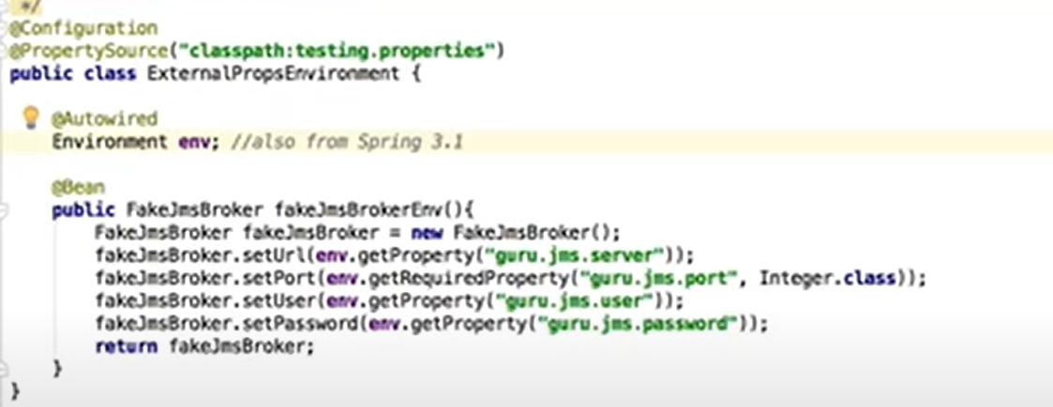

Slide 10
<beans profile="dev"> <bean id="devDatasourceConfig" class="org.baeldung.profiles.DevDatasourceConfig" /> </beans>
@Component @Profile("dev") public class DevDatasourceConfig

Slide 11
Logging
logging.level.com.example.LoggingDebuggingDemo.controllers=TRACE
logging.pattern.console=%d [%level] %c{3.} [%t] %m%n
logging.file.path=logs/
logging.file.name=logs/appLog.log
logging.pattern.file=%d [%level] %c{3.} [%t] %m%n

Slide 12
Customizing Banner
Banner.txt
Spring.banner.location=classpath:banner.txt
Spring.banner.image.location=classpath:banner.jpg

